Slide 1
Determining Department and Priority from email content using Fuzzy Logic
For our BSc project:
Fundamentals of Fuzzy Logic
Peter Heemskerk
Jim Kamans
Stefan Schenk
December 2017

Slide 2
Goal and relevance
For complex organisations it is difficult to answer email questions from customers / other parties in time.
Our goal: use content:
  to determine the correct department which should reply on an e-mail;
  determine a priority, to ensure that email gets sufficient attention at the right management level.

Slide 3
Literature
Spam
Priority setting

Slide 4


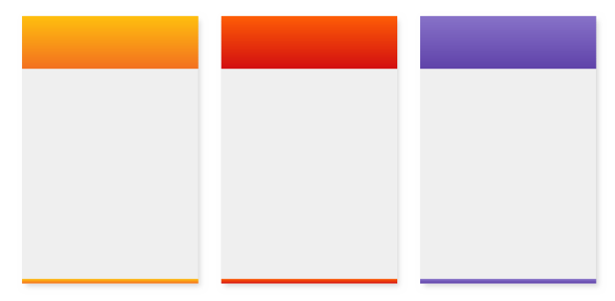


Approach
e-mail content:
– filtered / tokenized
– cleaned / stemmed
email
Data
preprocessing
wordlist
overlap with standard
word lists per feature
wordlist
Ranking
feature-score
combinatioin of features
makes department
and priority (fuzzy logic)
Classification
department
priority

Slide 5
Data after preprocessing
In te vullen door Stefan:
What does your data look like after pre-processing? Describe briefly. Show
a snippet with column descriptions.

Slide 6
Implementation
Python NLTK library:
– tokenizing
– filtering
email
Data
preprocessing
wordlist
Python
self development…
used learned /
self created word lists
wordlist
Ranking
feature-score
Python based on LAB:
– flexibel rule base
– more than 1 output
– COE defuzzification
Classification
department
priority

Slide 7
Experiments
1. Department determination:
– parametrized system manually based on inputs:
    Feature word lists generated from training email base, manually amended
  validation against data-set label
  validation score not satisfactory
2. Priority determination
– parametrized system manually
  validation against priority score of experienced email reader
  validation score not satisfactory

Slide 8
Limitations en observations
2 fases complicated, it was difficult to establish a learned baseline
Could not determine good feature word list
To discuss:
  Added value of fuzzy logic limited

Slide 9
Results
The following is achieved:
– a working python implementation of all steps.
– a score per feature based on manually made word lists
– department determination:
o validation against given labels in dataset
o score of x% not satisfying
– priority determination:
o validation against priority score set by experienced email reader
o score of x% not satisfying

Slide 10
Collaboration
Collaboration via tools:
    Google drive
    Github
    Trello: scrum board
Example screenshot of Trello with sprint x

Slide 11
Collaboration – 2
Stefan Datacleaning
          Methods
          Python implementation
Jim Ranking
          Methods
          Python implementation
Peter Classification – Fuzzy Logic
          Methods
          Python implementation
All Experimentation
All Reporing and Presentation

Slide 12
Conclusion and Discussion
Achievements:
  Learned about word preprocessing and standard tools avialable
  A working python implementation of Fuzzy Logic has given us insights of the detailed working
What we can learn from it
  Base design on a documented design. Our design appeared far away of everything documented.

